Slide 1

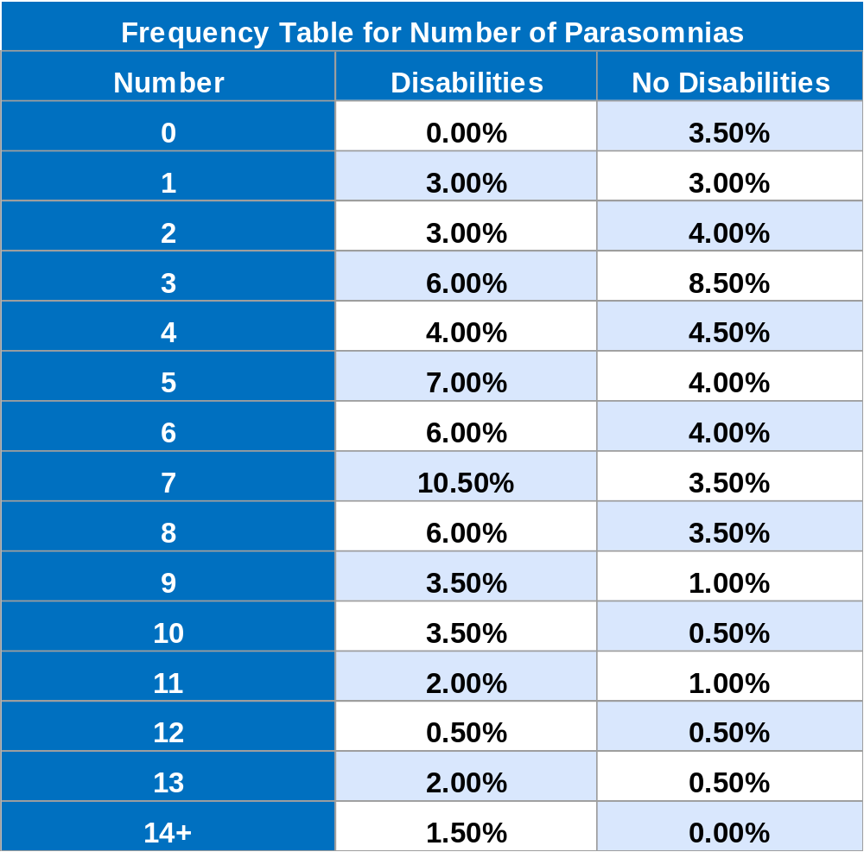




Have You Heard? The Impact of Disabilities on Prevalence of Parasomnias Among Post-Secondary Students
Abigaelle Vasseur^{1,2}, Huanan Liao^{1,2}, Bianca Zlotea^{1,3}, Yuxuan Qin^{1,2.}, Catherine Fichten^{1,2,3,4}, Alice Havel ^{1,2}, Mary Jorgensen¹
¹Adaptech Research Network, ² McGill University, ³ Dawson College, ⁴Jewish General Hospital
INTRODUCTION
RESULTS
Sleep can be impacted by many variables, including parasomnias
Parasomnias: Irregular events occurring during sleep that are characterized by atypical and bizarre behavior (e.g. hypnic jerks and nightmares)
Lack of research on parasomnias on post-secondary students and young adults
Those with disabilities are underrepresented in this type of research
Research question:
Is there a difference between the number of parasomnias reported by people with and without disabilities?
METHODS
Online survey:
200 participants who had been in school during the pandemic
64 participants had already finished their education
            Time out of school was under 5 years
136 participants were still in post-secondary school
32 females, 58 males, 10 nonbinary
Mean age: 24
116 participants had disabilities
41 had both physical disabilities and mental health issues
59 had only mental health issues, including ADHD
16 had only physical disabilities
84 participants had no disability
Munich Parasomnias Screening Questionnaire (MUPS):
Self-rating of prevalence for 21 parasomnias
Measure of number of parasomnias reported by each participant
CONCLUSION
Participants who have disabilities are more likely to have greater numbers of parasomnias
Participants with mental health issues are likely to have more parasomnias compared to those with physical disabilities
Implications:
It is especially important to provide resources regarding parasomnias, including coping strategies, to students with disabilities
Continue to include students with disabilities in research about parasomnias

