Slide 1

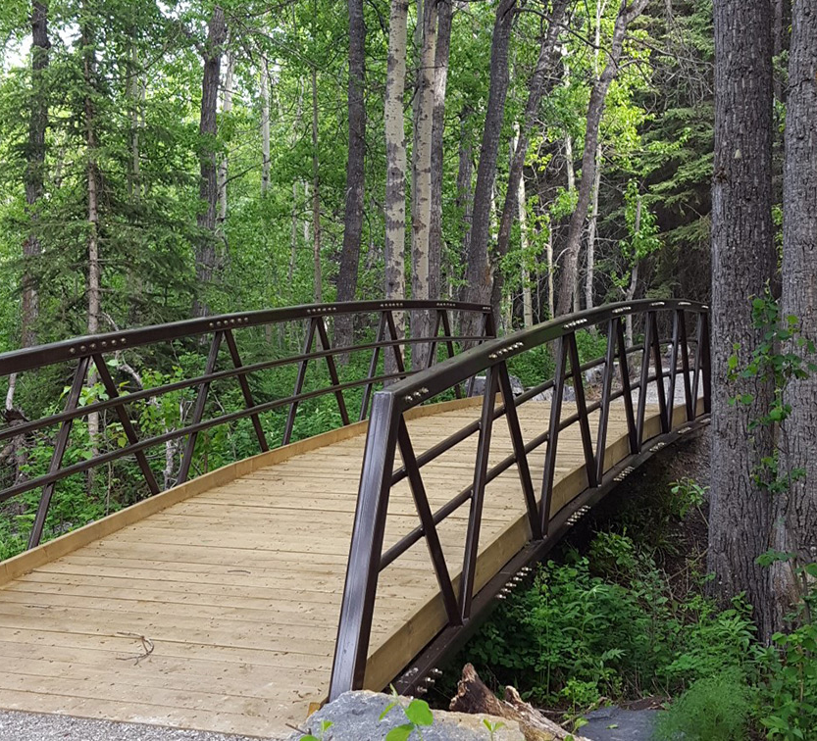
A Pocketful of Tools: Mobile Solutions to Bring to Internships
Susie Wileman, Alice Havel, Catherine Fichten, Mary Jorgensen
Adaptech Research Network
June 3, 2024
SALTISE Conference 2024

Slide 2
Who Are We?
Why Now?
Adaptech Research Network
Dawson College
ECQ
Universal Design
Success stories vs. Pushback
Silos of Knowledge
Notes:
Alice - Adaptech Research Network
Team of teachers, professionals, students with and without disabilities at the college and university level
Conduct research on post-secondary students with a variety of disabilities, the focus is (but not exclusively) on information and computer technologies
Based at Dawson College and funded solely by research grants
Adaptech has been around for over 25 years!
About Dawson
8 programs are part of the project as they are involve working with clientele in the health and human services programmes, including Social Services and Community Recreation Leadership Training.
About ECQ: The Entente Canada – Québec supports second language instruction and minority language instruction, hence in Quebec, English.
Grants are awarded through an annual call for proposals open to colleges and universities.
ECQ supports projects that target diverse needs within a given institution.
(small ‘r’ research/deliverables)
Why Now?
There are challenges associated with the transfer of universal design principles used in accessible and inclusive classrooms to the clinical internship setting – While academic settings are more often inclusive nowadays, inclusion is inconsistent/variable in the internship/fieldwork environment.
As two of members of the team are/were accessibility advisors. We have all heard of the success stories, we also encountered plenty some pushback, and that is what motivated our interest studying this issue.
Silos of knowledge, e.g.,While we might know about UD, and students may to know what to expect or how to access accommodations in the internship setting, the competencies required in clinical internships are unknown territory for many accessibility advisors. At the same time, the application of UD in clinical internships is unknown territory for faculty who are clinical internship supervisors.

Slide 3

Goals of the Project
Explore facilitators and barriers
Include voices of three stakeholder groups
Create ‘deliverables’
Notes:
Susie - Back to research with a small ‘r’:
Provided an opportunity to examine barriers and facilitators in clinical internship / fieldwork settings
Allowed us to include the voices of stakeholders in this study:
Students with disabilities - harkens to ‘nothing about us without us’
Faculty responsible for supervising them in the internship milieu - people best placed to understand the unique demands of the settings
Accessibility advisors – best placed to facilitate communication regarding overall student needs and accommodations
Missing voices are those of the on-site non-faculty supervisors (preceptors) (harder to reach as not part of the college)
Deliverables
Videos / handouts/ testimonials (multiple means of representation)
For all stakeholder groups, with input from each stakeholder group
Handouts on use of technology and on UDL
Interestingly, the preparation of the deliverables was the start of collaboration between some of the stakeholders. Each stakeholder ‘holds’ different pieces of information.

Slide 4
Method
Advisory Board Meeting
    Faculty
    Dean
    Students with disabilities
    Accessibility Centre Advisor
    Pedagogical Counsellor
Individual Interviews x 3 groups
    Faculty fieldwork/clinical supervisors (n. 10)
    AccessAbility Centre advisors (n. 8)
    Students with disabilities (n. 14)
Thematic Analysis
Notes:
Susie (suggest we move through this one fairly quickly)
Advisory Board meeting in the fall 2022, on Zoom.
Asked them for their perceptions on barriers / facilitators to internships encountered by students with disabilities and specific challenges faced by students, faculty supervisors, the college
3 sets of questions were developed
Review Board Ethics Approval
Interviews
30 minutes, confidential, on Zoom or telephone (choice of participant)
Used note-takers
32 participants
I’ll will speak briefly about questions in the next slide.
Thematic Analysis
We had to learn about how to best do this as we are more familiar with coding
Article on thematic analysis (backdoor)
Switch back to Susie, to discuss the method

Slide 5
Questions We Asked
Students
Facilitators
Barriers
Resources
  assistive technologies
  strategies
Role of the college
Recommendations
Faculty
Service Providers
Notes:
Susie (same here – need to move through this one fairly quickly)
Our Questions were formulated as prompts to encourage open-ended responses from the three, key stakeholder participant groups. We were really interested in finding out from the them (missing on-site supervisors)
What they found to be helpful or successful in internship settings, especially regarding the use of technology
What were some of the challenges unique to these settings, and any
Recommendations they might have.
We asked questions based on topics identified both through our review of the literature and the Advisory Board. But, as we discovered, the resulting themes turned out to be different from the interview questions themselves. Which is not necessarily a bad thing! In fact, it’s probably a good thing. Looking at themes that emerged from answers, Communication in many forms, stood out.
I’m going to turn this over to Alice, who will outline the emerging themes

Slide 6
Emerging themes
Institutional Policy & Legislation
Communication
Knowledge
Notes:
Alice
“Here’s the nub of what emerged thematically, and it shouldn’t come as a big surprise to the assembled…it’s all connected!”
Communication between the stakeholders was the primary emerging theme, followed by what is being communicated: the knowledge held by each stakeholder group. And of course, elements of communication and knowledge are also informed by policy & legislation as it impacts on communication ( i.o.w.s who is permitted to say what to whom).
Each of the three areas have their subthemes. As an example, Knowledge can be seen to have 3 subthemes based on the specific knowledge stakeholders are looking for. This includes
Best practices
Program competencies and evaluation
Accommodations / Support
Part of best practices is what has already proven to be effective, which speaks to role models and mentorship. In other words, stakeholders don’t think that they need to reinvent the wheel, but they would dearly love to see examples of that wheel in motion!
We’ve already touched on what Accessibility advisors feel they lack in terms of knowledge about the competencies required in the various programs. While on the other hand, internship supervisors feel they don’t know enough about various disabilities, and what reasonable accommodations can be put in place in internship settings. Some faculty expressed concern about the difficulty associated with wanting to know more about individual students’ disabilities in order to provide targeted support versus the need to respect students’privacy. So, to our thinking, there was certainly room in the deliverables for introducing approaches based on universal design, rather than disabilities-specific interventions.
Last but not least, we suggest that the role of accessibility services can be seen as a key player in the outcome of students with disabilities in internship settings. But this raises further questions, for example, is the role of accessibility advisors limited to the provision of accommodations, or are they, (also) advocates and even sometimes, policymakers/or people who inform policy in their institutions? It’s a complex issue.
Interestingly, in the process of considering these themes we started to wonder if the preparation and distribution of deliverables to the stakeholders would provide an opportunity to enhance communication between these groups. In other words, we wondered if we could get some of them on board and involved with the creation of deliverables might it spark more exchange between them. Hang on this one, because they’ll be more about this after we talk about those deliverables.

Slide 7
Toolkit
1.Resources created Adaptech Research Network:
  Handouts
  Articles
  PowerPoint presentations
  Videos
2. External Resources
https://adaptech.org/internship-toolkit/
Notes:
Alice
Here’s an outline of what is going to be in the toolkit
Not all there yet, but some are up on website and you access here.
I also would like to mention that we are delighted to be able to capitalize on some of Cathy Roy’s work on UDL in clinical education. This is very exciting work.
(mention link, but no need to click on it)

Slide 8
Videos
  Video on how technology is being used in clinical settings
  How-to video clips demonstrating tech
  Video on disclosure
https://adaptech.org/internship-toolkit/
Notes:
Susie: Get ready for the show and tell

Slide 9
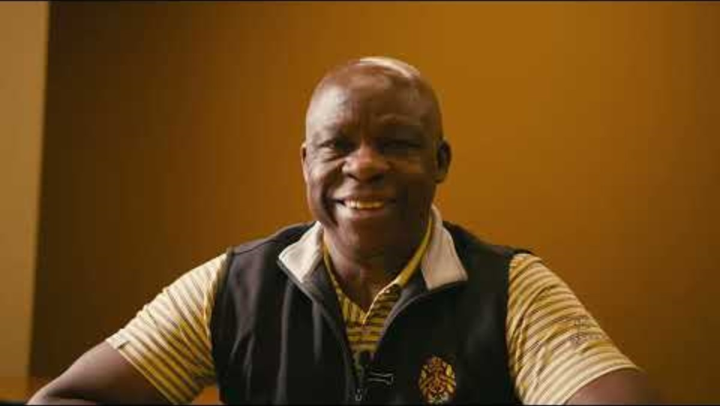
Notes:
Want the disclosure video from You Tube in this space.

Slide 10
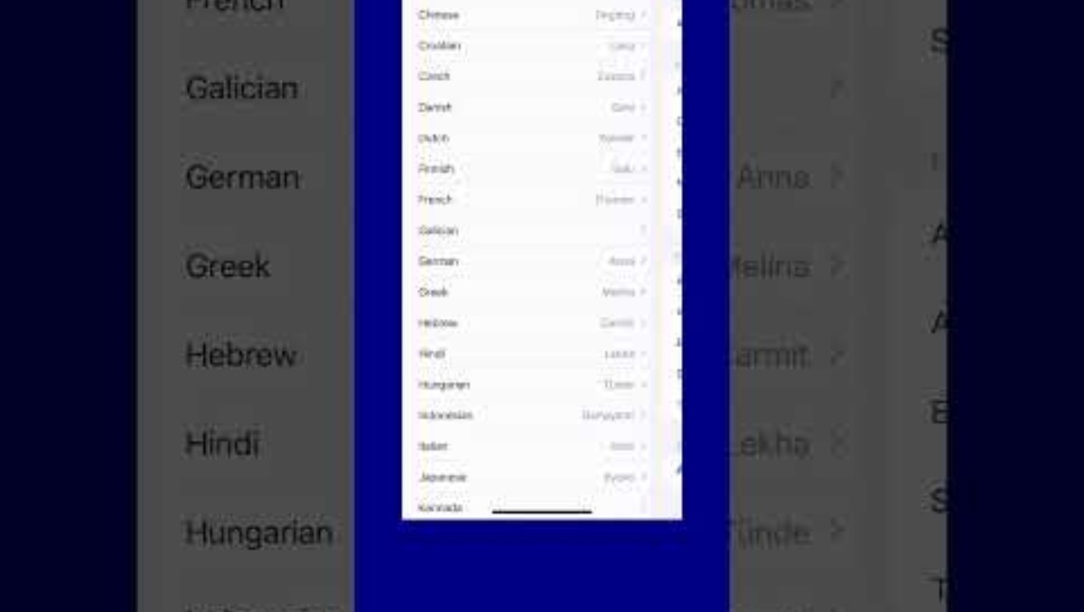
iPhone Text to Speech Function
Notes:
Guissou Iravani-Manesh is Dawson’s AccessAbility technologist. She developed 5 short videos on different tech. Here’s one example

Slide 11
iPhone Dictation Function

Slide 12
Questions / Comments
Notes:
Alice and Susie

Slide 13
Link to Toolkit
https://adaptech.org/internship-toolkit/

Slide 14


Thank you!
Adaptech Research Network www.adaptech.org
Susie Wileman swileman@dawsoncollege.qc.ca
Alice Havel
ahavel@dawsoncollege.qc.ca a
Catherine Fichten
catherine.fichten@mcgill.ca
Mary Jorgensen
mjorgensen@dawsoncollege.qc.ca
Funded by Entente Canada-Quebec
Notes:
Susie: Close & read aloud Adaptech address

